Slide 1

LIBER Conference 2023
Data Science in Libraries Working Group
Data Science in Libraries
LIBER Annual Conference 2023-07-05, Budapest

Slide 2
Workshop Agenda
9:15 – 9:30 About us, and what is our topic?
9:30 – 10:10 Short overview of the survey result
10:10 – 10:30
Discussions

Slide 3
Practical Things
Links
Survey: https://survey.uu.nl/jfe/form/SV_eswlDMEJuaf9nGS
Slides: https://bit.ly/dslib-2023
Collaborative Document: https://bit.ly/dslib-2023-notes
Social Media
Tweet with @LIBERConference & @LIBEREurope & #LIBER2023!
Before tweeting, check for any privacy-related concerns in the group.
I’m also happy to make new library friends @kiru@openbiblio.social
Have fun!
https://bit.ly/dslib-2023

Slide 4
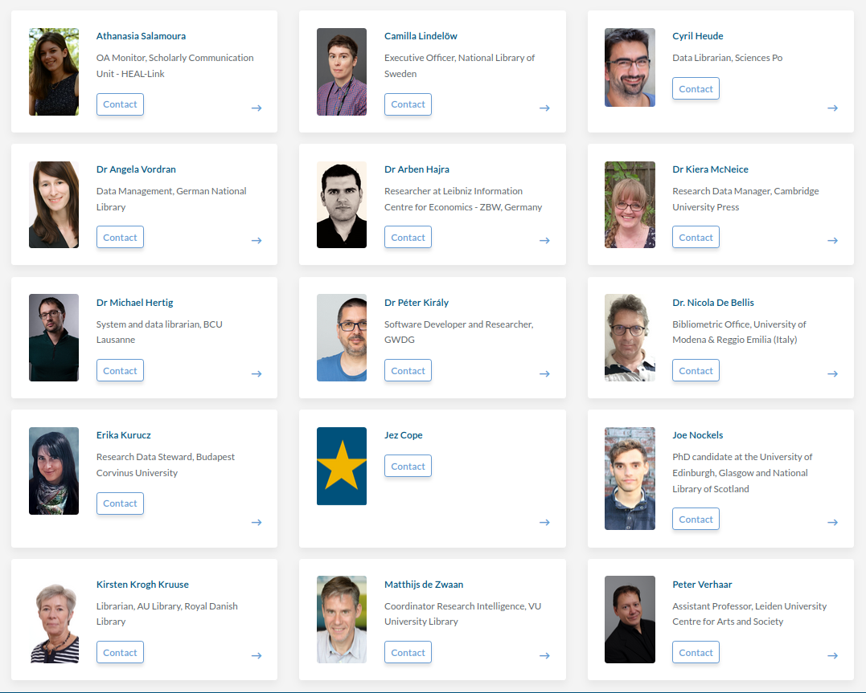
PART 1 09:15 – 09:30
https://bit.ly/dslib-2023

Slide 5
about us
https://libereurope.eu/working-group/liber-data-science-in-libraries-working-group/
founded: 2021 spring
15 members
aiming: survey and landscape analysis
monthly meetings
forming definitions
show cases
reading papers
information exchange
guests
looking for chair(s)
https://bit.ly/dslib-2023

Slide 6
DSLib definition(s)
https://bit.ly/dslib-2023
What is your definition/idea of data science in libraries?

Slide 7
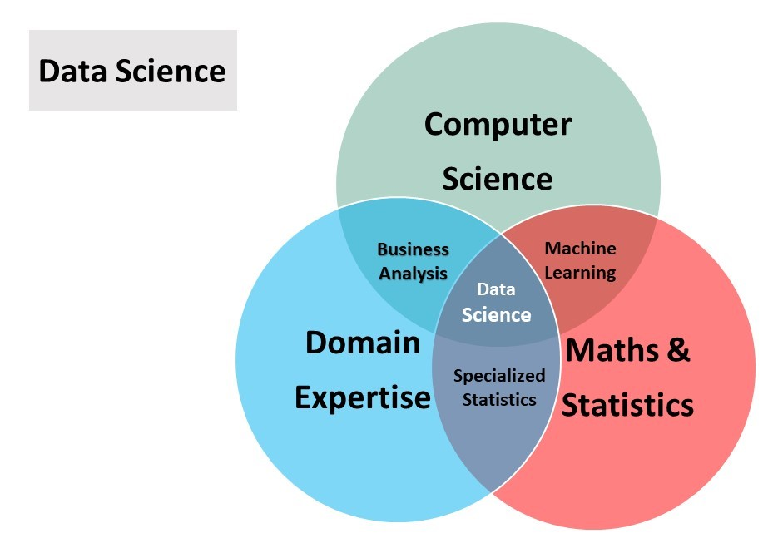
data science
is a set of computational methods for the identification of novel and actionable insights from data
https://bit.ly/dslib-2023

Slide 8
computational methods
include (but are not limited to)
descriptive and inferential statistics
visualization
text mining
image processing and computer vision
machine learning
data engineering
https://bit.ly/dslib-2023

Slide 9
data science in libraries
is the use of these methods in the delivery and/or improvement of library services and the delivery of data science training or services.
https://bit.ly/dslib-2023

Slide 10

DSLib Activities
What are some examples of data science activities you (wish to) carry out at your library?
https://bit.ly/dslib-2023

Slide 11
Collections as Data
Data science activities that facilitate the use of library collections in computationally-driven research and teaching. This can include activities that ensure that data from library collections are high-quality, rich with information, reliable, suitable for analysis, and easily accessible for computational interactions.
https://bit.ly/dslib-2023

Slide 12
Collections as Data
data pipelines that are created to enhance the quality of data
machine learning and computer vision techniques used to:
generate data
discover resources
identify and extract rich metadata and/or full-text from documents
https://bit.ly/dslib-2023

Slide 13
Library Intelligence
Data science activities geared towards the improvement of traditional library services and support for decision-making by library management.
https://bit.ly/dslib-2023

Slide 14
Library Intelligence
data-driven item suggestions for library patrons
the application of machine learning techniques in the management of library material flows
the use of library loan data analytics in collection management
automated library analytics for day-to-day planning and annual reports
https://bit.ly/dslib-2023

Slide 15
Research Support
Data science activities to support researchers through the research lifecycle. This can cover areas such as research data management, research data/software engineering, digital humanities, and (digital) information skills.
https://bit.ly/dslib-2023

Slide 16
Research Support
data management planning
research data/software engineering
ensuring data FAIRness (findability, accessibility, interoperability, reusability)
data curation and preservation
working with Linked Open Data and digital corpora
data science methods in (automated) systematic searches and literature reviews
https://bit.ly/dslib-2023

Slide 17
Research Intelligence
Data science activities in compiling and visualizing data for decisions and benchmarking within the scientific community. Given the scale of the data available, Research Intelligence often requires the implementation of data pipelines and dashboard tools.
https://bit.ly/dslib-2023

Slide 18
Research Intelligence
data:
metadata of publications
other research outputs
data related to these outputs such as citations
activities:
continuous development of analysis workflows
combining traditional citation metrics with alternative metrics such as policy citations
https://bit.ly/dslib-2023

Slide 19
PART 2 – Survey results
09:30 – 10:10
n = 50
https://bit.ly/dslib-2023

Slide 20
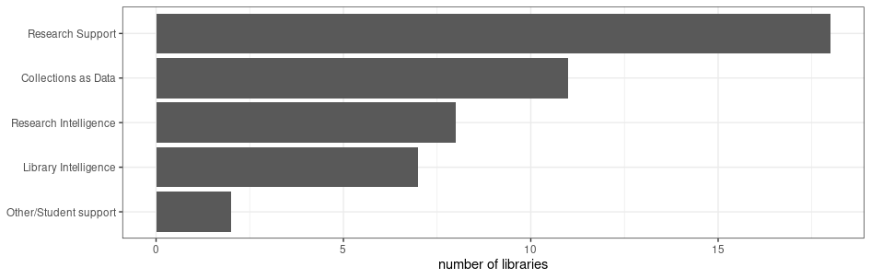
Q7/Q8
Which categories apply to your data science activities?

Slide 21
Q9
Describe the current data science activities in your library.
https://bit.ly/dslib-2023

Slide 22
Q9: library intelligence
catalogue related
automated cataloging
enrichments of bibliographic records
automated subject indexing
automate the acquisition of metadata
data quality:
normalisation/disambiguation of persons and corporate bodies,
linking between data sets,
enrichment with IDs,
content indexing
visualization of authority file records
https://bit.ly/dslib-2023

Slide 23
Q9: library intelligence
usage analysis
analyzing user behavior in the catalogue (bibtip)
data on space occupancy in study spaces
journal renewal
semi-automated de-selection
evidence based acquisition
analyzing query logs
COUNTER stats, loan statistics, Leganto stats
https://bit.ly/dslib-2023

Slide 24
Q9: research inteligence
bibliometric analysis
campus output breaks down by publisher share
analyze research impact
https://bit.ly/dslib-2023

Slide 25
Q9: research support
geo-referencing (crowdsourcing)
hand written text recognition (HTR) with Transkribus
publishing metadata
attribute PIDs to elements of metadata
research data management advisory service
https://bit.ly/dslib-2023

Slide 26
Q9: other
automating the process for systematic literature reviews
ChatBot
text mining
analyzing watermarks
automated interactive dashboards
trend analysis
https://bit.ly/dslib-2023

Slide 27
Q10
Which department(s), team(s), or similar entities carry out data science activities in your library?
single person
an existing unit with new tasks
several library units
cross-cutting working group
dedicated team
research support
data management
scholarly communications
research software engineering
acquisition and cataloguing
https://bit.ly/dslib-2023

Slide 28
Q11
Describe the staff responsible for data science activities.
background
LIS
Computer Science
Digital Humanities / Computational Literary Studies
other
qualifications
self-taught
workshops
field-specific training
roles
librarians
data specialists
data scientists
research data engineers & consultant
metadata managers
https://bit.ly/dslib-2023

Slide 29
Q12
Who does the library collaborate with, internally or externally to the institution, in carrying out data science activities?
vendors, suppliers
IT department
university Working Groups
individual researchers
university grants office
data stewards
other academic libraries
publishers
research consortia
https://bit.ly/dslib-2023

Slide 30
Q13
What are the challenges faced by the library in carrying out data science activities?
lack of staff
time to get the qualifications
high demands, low resources
OCR problems
copyright issues
lack of physical back-up storage
data quality
fixed term contracts in projects
lack of awareness
lack of institutional policies
lack of budget
researchers not sharing datasets
researchers lack a good understanding of techniques
MVP section of this workshop
https://bit.ly/dslib-2023

Slide 31
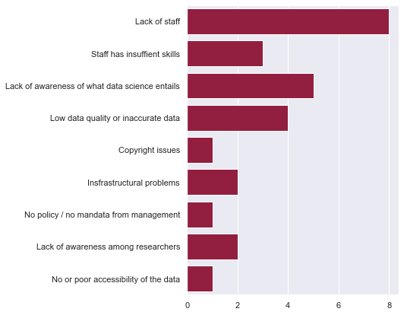
Q13
What are the challenges faced by the library in carrying out data science activities?
https://bit.ly/dslib-2023

Slide 32
Q14
Does the library have ways of addressing legal or ethical challenges related to data science activities?
considering rights and terms in data collecting phase
Copyright Information Point / university legal/privacy department/officers
CARE principles, CC0
no personal data are collected
ethical aspects of bibliometric analyses
difficult questions (e.g. what can we do with abstracts…?)
restricted materials are only accessible on the premises of the library
https://bit.ly/dslib-2023

Slide 33
Q15
How are the data science activities typically funded?
internal funding
university funding
government
national research funding agencies
European research funding agencies
https://bit.ly/dslib-2023

Slide 34
Q16
What library data science activities are planned (if any) in the future?
publishing/author profiles
cataloging with AI (data enrichments, subject indexing)
usage analytics
name disambiguation and clustering
duplicate detection
developing data science skills (for staff, researchers, students)
involvement in research projects
collections as data
monitoring research activities
(research) data repository
knowledge graph/hub
https://bit.ly/dslib-2023

Slide 35
Wrapping Up…
https://bit.ly/dslib-2023

Slide 36
Closing
Thanks for being here!
Would you be open to being contacted for the survey?
Would you like to join our WG or contribute in any other way?
Links:
Survey: https://survey.uu.nl/jfe/form/SV_eswlDMEJuaf9nGS
WG website: https://libereurope.eu/working-group/liber-data-science-in-libraries-working-group/
WG open notes: https://hackmd.io/@nehamoopen/liber-dslib/
https://bit.ly/dslib-2023

Slide 37
Thanks!
Email: pkiraly@gwdg.de Mastodon: @kiru@openbiblio.social
Github: https://github.com/pkiraly
https://bit.ly/dslib-2023

Slide 38
Unused slides

Slide 39
data science activities
creating infrastructure for digital collections
clustering work bundles (FRBR/LRM)
links to authority records (entity recognition, entity linking)
automatic subject indexing (Finnish Nat. Lib.’s Annif – https://annif.org/)
visualization
statistical analysis
text and data mining
open data
IIIF Image API
language detection
automated retrieval of citation information
providing easy access to text resources
knowledge graph
Carpentries
book club
teaching in LIS courses
topic modelling
linguistic analysis
metadata quality assessment
license and right management

Slide 40
Landscape Analysis
The WG needs your input to develop the landscape analysis!
✏ Write out your thoughts and ideas in your subgroup’s collaborative document.
🗨 Discuss with your subgroup as you go.
📃 Provide a summary in the Google Doc and report back to the whole group.
Some discussion/reflection prompts:
What kind of data do you (wish to) work with?
What are the opportunities and challenges with respect to carrying out data science in libraries?
If the WG works on a landscape analysis/report/advice/recommendation:
What kind of information would you like to see?
What kind of information do you think all libraries would benefit from?
What else would you want out of our WG’s activities? Where can we provide the most valuable input?
.

Slide 41

DSLib Survey
👁‍🗨 Skim through the survey and imagine filling it out yourself/for your library.
What are points for improvement? What is missing?
🗨 Discuss with your subgroup as you go.
https://survey.uu.nl/jfe/form/SV_eswlDMEJuaf9nGS

